Slide 1
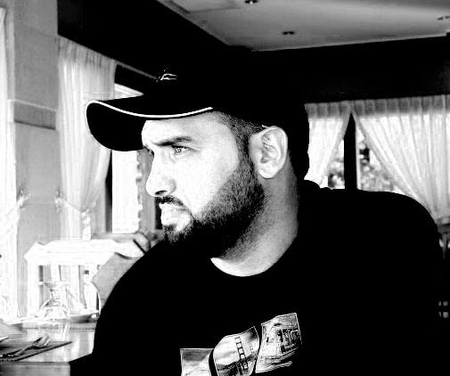

Install IDE
Abdulkarim Albanna
www.abedelkarim.com
www.facebook.com/abdulkarimAlbanna

Slide 2
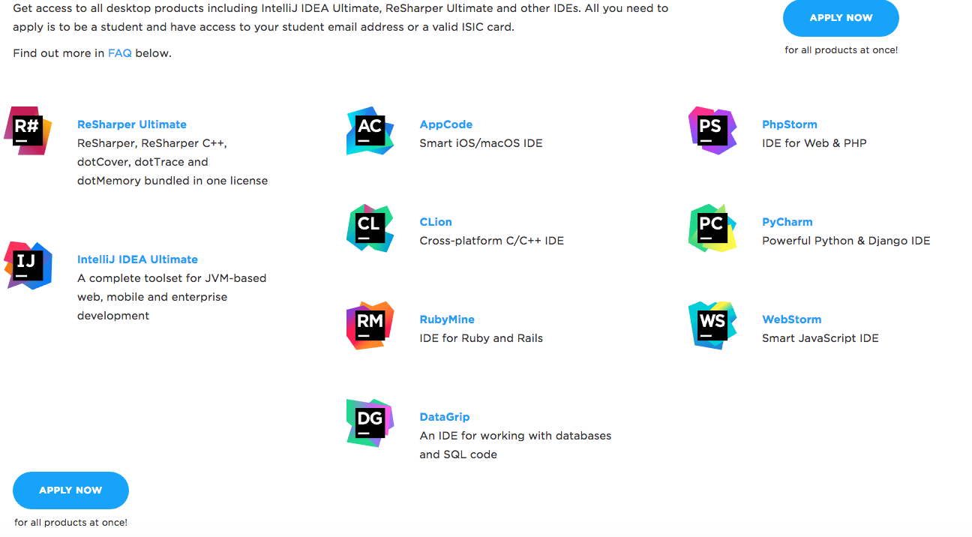
https://www.jetbrains.com/student

Slide 3
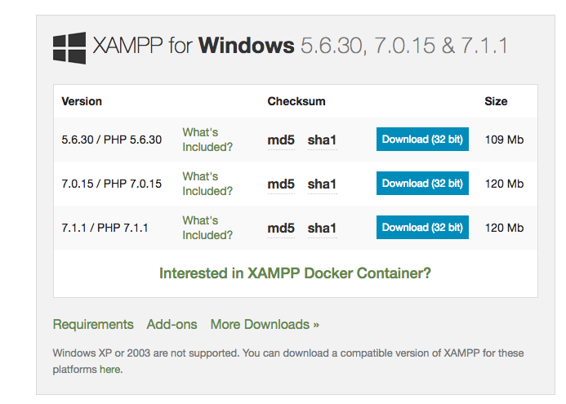
https://www.apachefriends.org/download.html

Slide 4
